Slide 1



Algorithmic Thinking: Or How to Think Like a Computer!
Framework Training

Slide 2
Plan for Session
Algorithmic Thinking
Problem Decomposition
Abstraction and Modelling

Slide 3

Algorithmic Thinking
Solves problems that allow an algorithmic solution
How do you make toast?
How do you buy a cinema ticket?
How do you make a cup of tea?
How do you get to the airport?
All of the above have algorithmic solutions
You use Algorithmic Thinking everyday

Slide 4
An Algorithm
Something which could be implemented by a computer
How do you book a holiday?
each step could be part of an algorithm
which could be implemented in a computer system
But doesn't mean that it has to be implemented by a computer, a piece of paper would do just fine!

Slide 5
Algorithmic Concepts
Sequence

Slide 6
Algorithmic Concepts
Print welcome
Calculate total
Print result
Sequence

Slide 7
Algorithmic Concepts
Sequence
Selection

Slide 8
Selection/Conditional Flow of Control
Very common in algorithms
Is the test true?
Flowchart
Yes
No
Execute this statement(s)
Execute this statement(s)
Carry on from here

Slide 9
Selection/Conditional Flow of Control
Sometimes represented as pseudocode
if a test evaluates to true then
execute these conditional statement(s)
else
execute these conditional statement(s)
end if
Carry on from here

Slide 10
Algorithmic Concepts
Sequence
Selection
Iteration

Slide 11
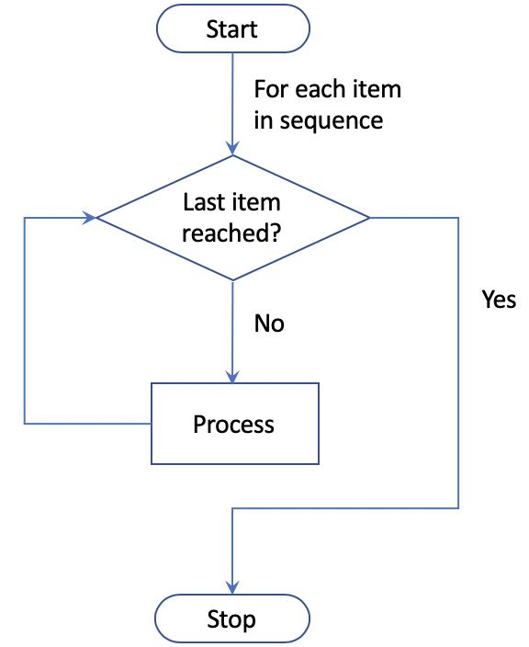
Processing a Sequence of Values

Slide 12
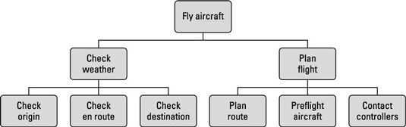
Problem Decomposition
Often involves problem decomposition
How to break a larger problem down into smaller chunks

Slide 13
Abstraction and Modelling
Need to abstract real world and model inside program
See this in your
everyday lives
Implementation
Representation
Model
Reality

Slide 14
Abstraction and Modelling
Abstraction is just a way of managing complexity
Examples of abstraction and modelling:
Maps of various kinds
Musical notation
A Calendar
A Timetable
A Room Layout plan
Typically only represent information that is useful / meaningful for the current problem
E.g. Room layout may not include height of room, colour of walls etc.

Slide 15
Abstraction and Modelling

Slide 16
Abstraction and Modelling

Slide 17
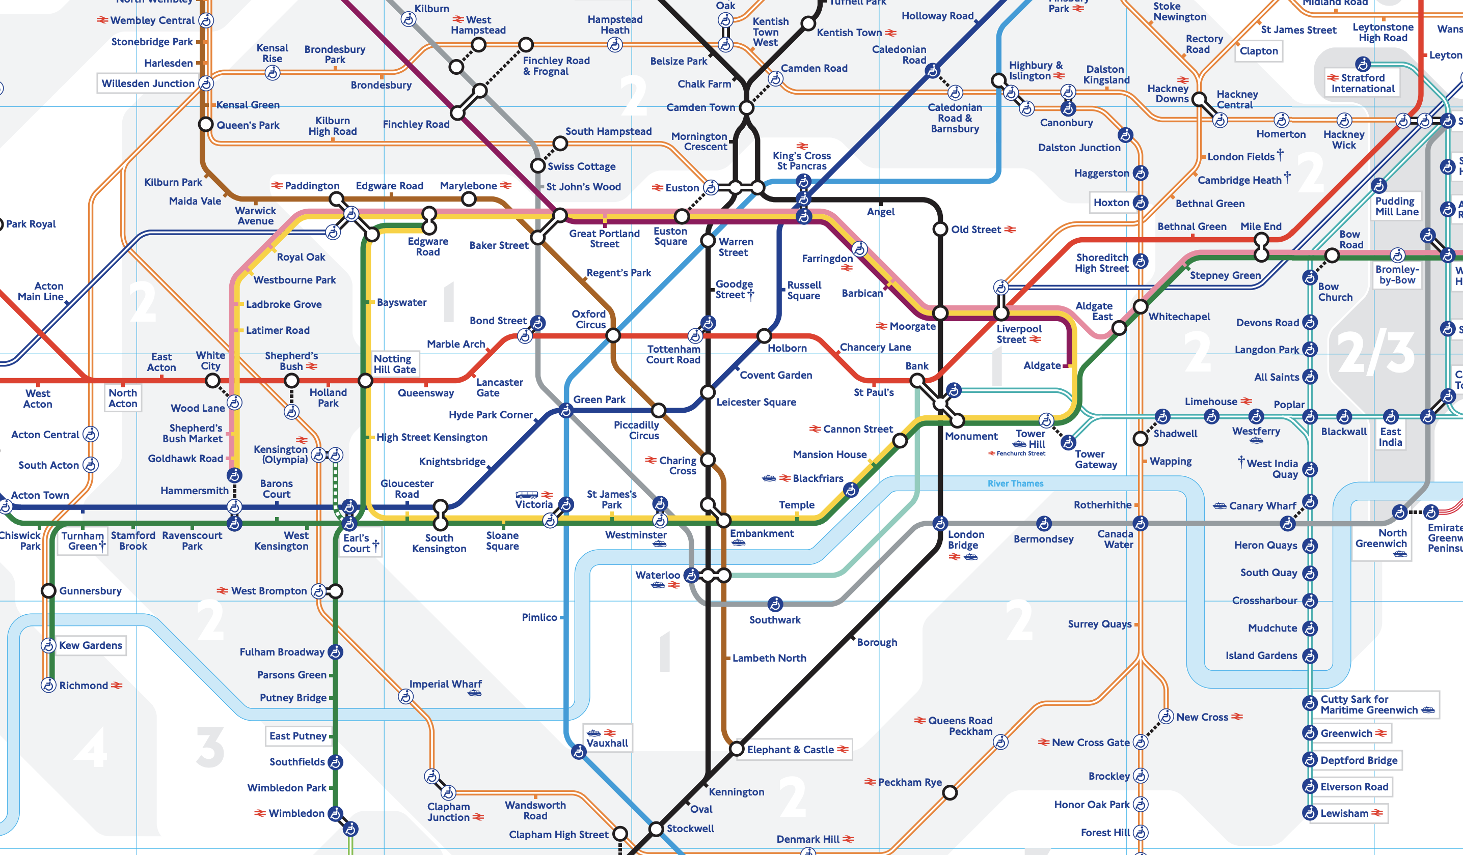
Abstraction and Modelling

Slide 18
Questions?
?

